Slide 1
Interacting with Smart Things
Internet of Things
Module lead: Dr Mir Seyedebrahimi

Slide 2
Recap: IoT scope’s clarification
Clarification of the IoT scope that is considered for this module:
IoT is a network of identifiable and interacting Things
Networking
Embedded system devices

Slide 3
Recap: IoT architecture reference
Clarification of the IoT reference model that is considered for this module:
Portals/Dashboards/APIs
Analytics/Services
Device/ID Managers
Access Managers
Gateways/Aggregators/Local servers
Communication Protocols
Device/Thing/SmartThing

Slide 4
Recap: Reference model - a practical view
Analytical tools and user portals
Identification and security management
Remote server/cloud services
Gateway
Local process/analytics
uC
uC
Devices
Devices
Things
Things
Smart Devices

Slide 5
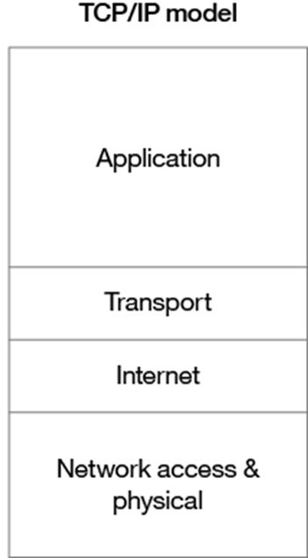
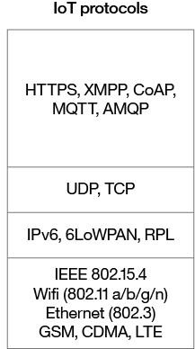
Recap: IoT protocol stack
Clarification of the IoT protocol stack that is considered for this module:

Slide 6
Recap: solution development approach
Within the scope of this module, IoT solutions require the inclusion of the following details:
Physical Entity View: and the exact physical properties of the desired ‘Things’ as much as relevant to the solution
IoT Context View: which is the IoT-related technical details of the solution mainly from end-user device and networking points of view
Information View: which is mainly the description and visualisation of required data sets, objects, their corresponding properties and parameters as well as their inter-relationships

Slide 7
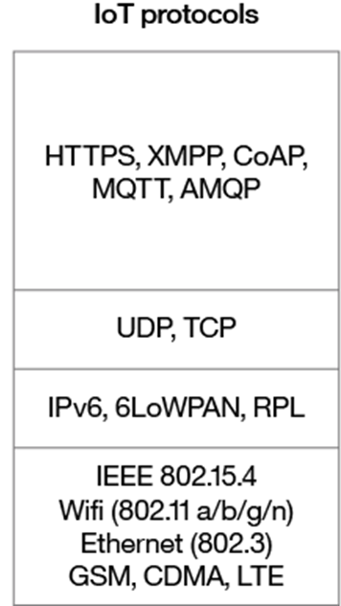
Recap: Network architecture
So far, we have introduced the first building block of an IoT architecture: the ‘Things’
The second block to build an IoT solution will be the ‘Network Architecture’
Networking aspect of IoT will be initially focused on defining appropriate first 2 layers of IoT protocol stack comprising the connectivity and the addressing points of view
The higher layer protocols and apps then can be defined accordingly (capabilities/performances are dependant on the first two layers’ specifications)

Slide 8
Continuation of the discussion: ‘Things’ Control methods
Direct Control:
interact with an object directly through the object itself.
This is a self-reliant object and not yet to be considered as a connected ‘Thing’
Local Control:
interact with the ‘Thing’ using a digital or analog interface locally connected to the object.
Remote Control:
interact with the ‘Thing’ over a network (e.g. an IP network). In most cases, this means interacting with an IoT Registration Server or an IoT Gateway.

Slide 9
Continuation of the discussion Today’s plan
Today’s work will be mainly a step by step integration of physical objects/Things over the network and corresponding protocols. These include prepacked smart devices and newly created things:
Smart Things:
that are Registration Server or Home Gateway compatible and can be controlled from a condition-to-actions UI interface
Components:
that plug into digital or analog slots on a microcontroller (MCU) or single board computer (SBC)
Additionally, it is possible to create Things:
Things are physical objects and are only bound to the user's imagination
These can be everyday Things like coffee makers, microwaves or more complex Things like space rovers. The Things are programmable and can interact with Packet Tracer's Environment.
Note: further work with the above features may require programming in JavaScript, Python, or Visua and also to manipulate the components.

Slide 10
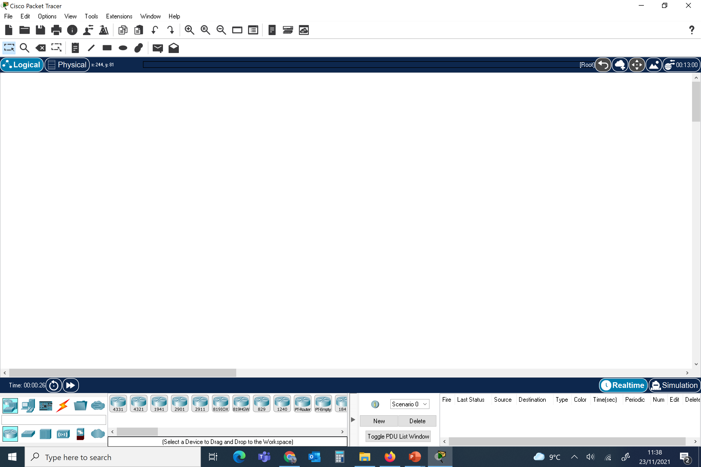
Recap: Cisco Packet Tracer (ver 8.0.0)

Slide 11
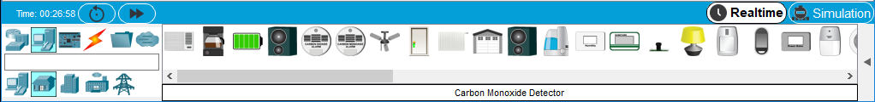
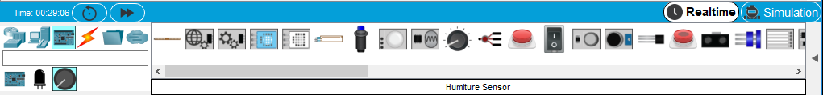
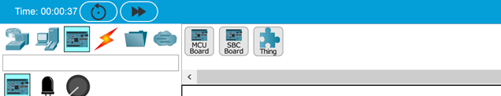
Interacting with Smart Things
Prepacked devices
Programmable elements

Slide 12
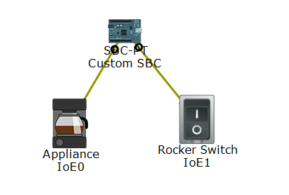
Direct or local control
Or for example through a locally connected switch
Device can be controlled directly

Slide 13
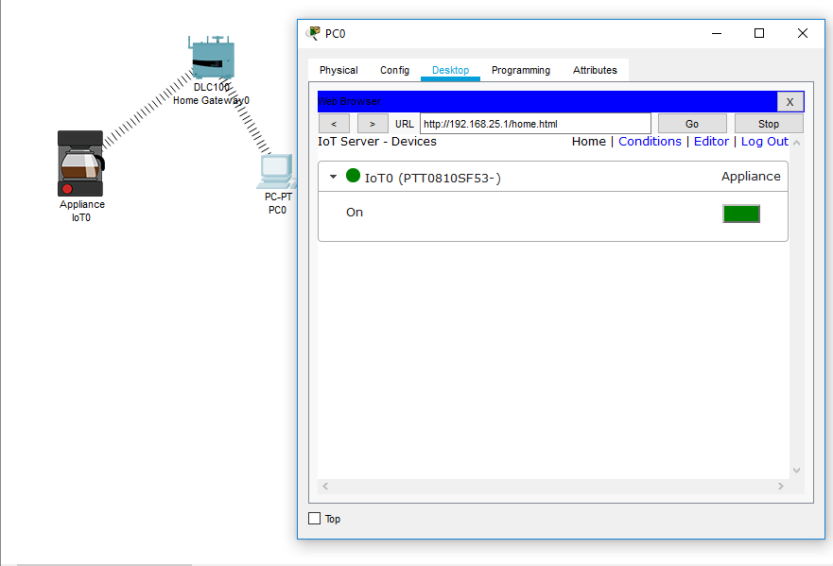
Remote Control: Home Gateway
Control through Home Gateway

Slide 14
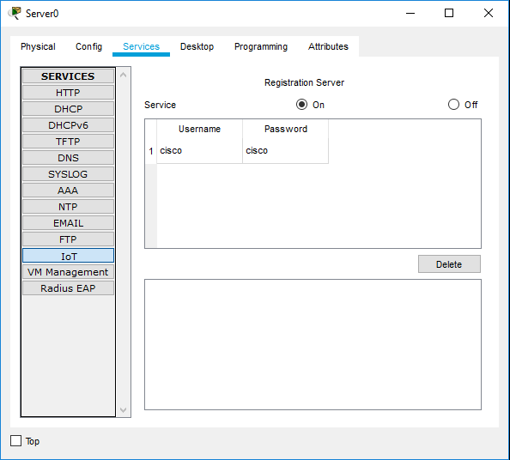
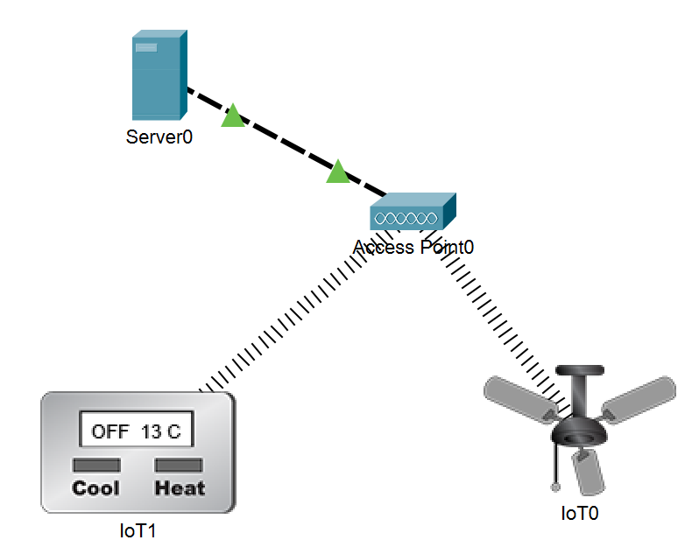
Remote Control: Registration Server
Control through IoT Registration Server:
Enable the IoT server
Monitor through desktop app

Slide 15
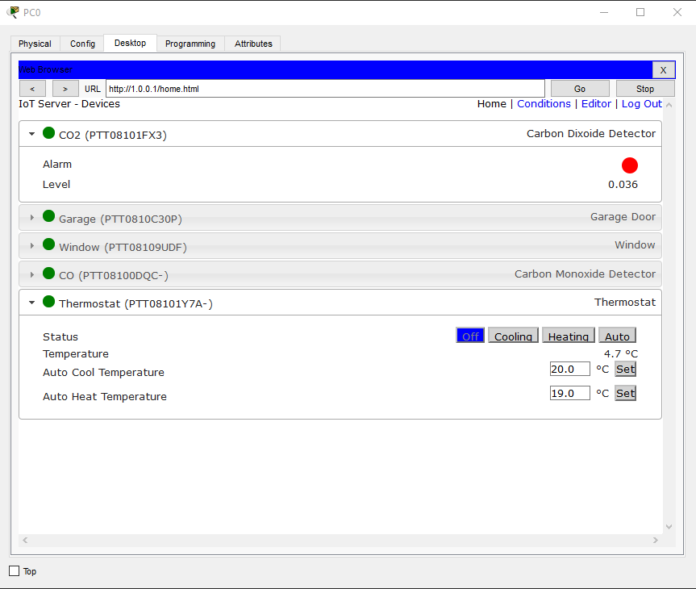
Accessing IoT Registration Server
Things are accessible through a desktop monitor app or direct browsing the Home gateway or registration server

Slide 16
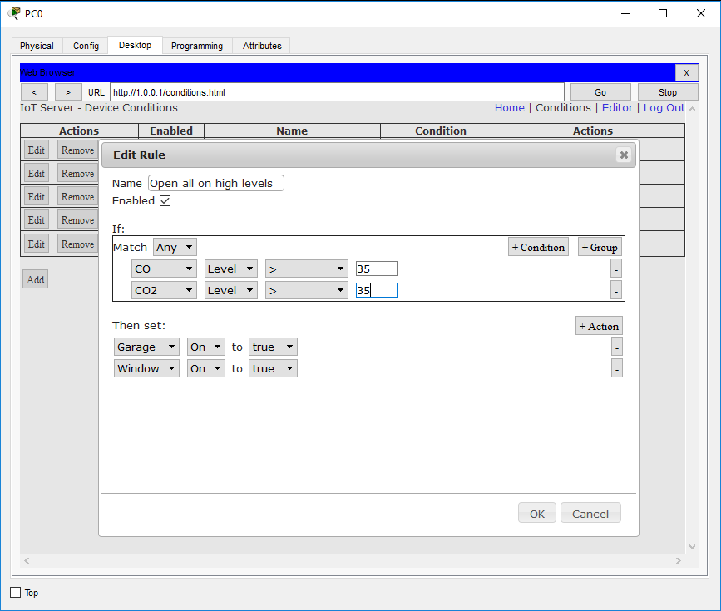
Conditional acts
Integrated elements can be monitored, controlled and/or interact based on predefined conditions mainly applied to the selected parameters

Slide 17
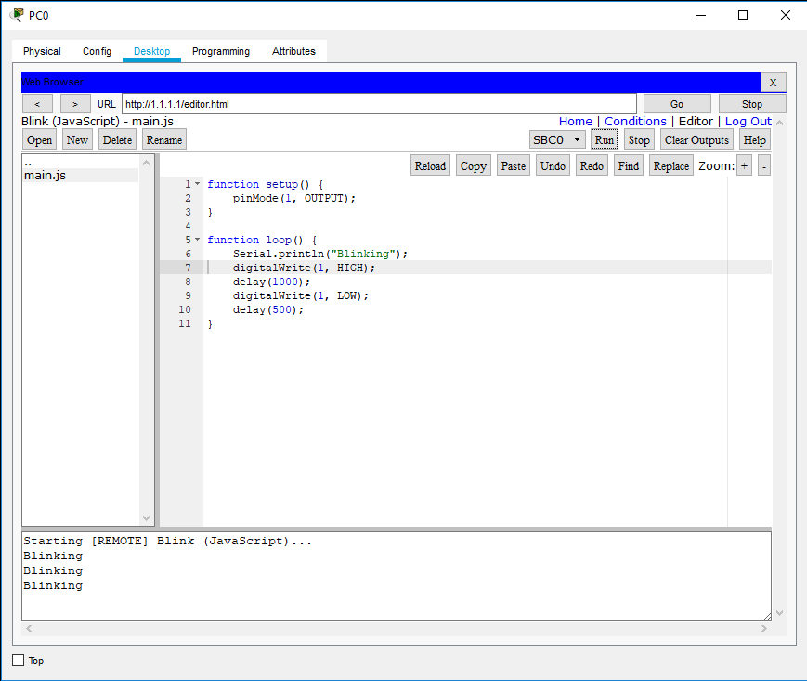
edit programming projects

Slide 18
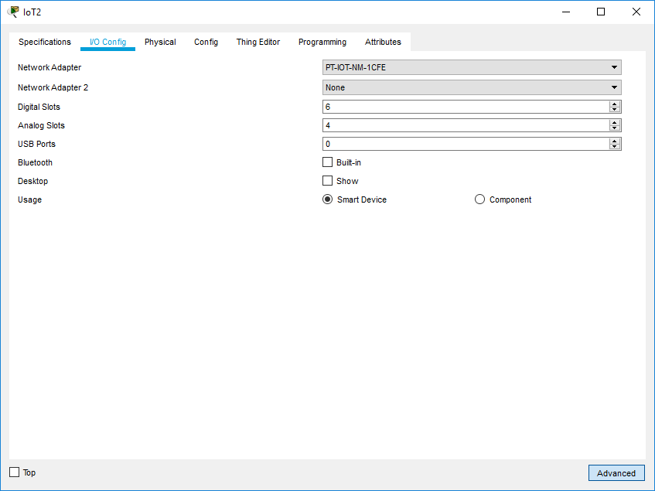
Creating Things

Slide 19
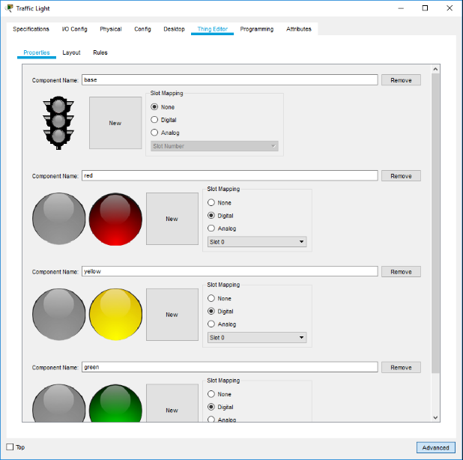
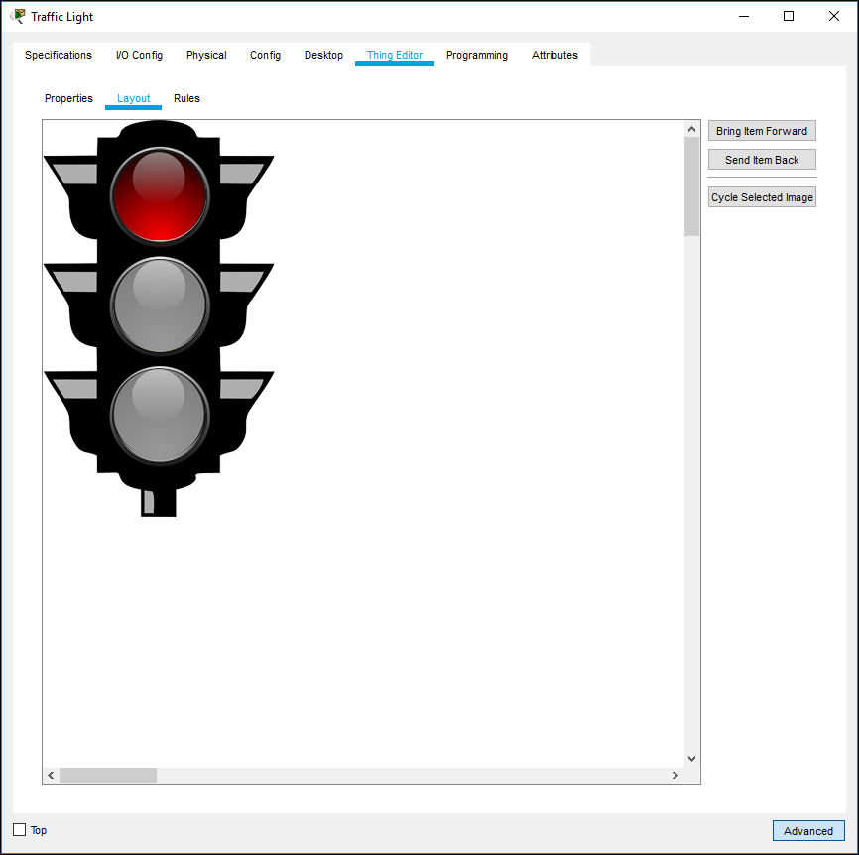
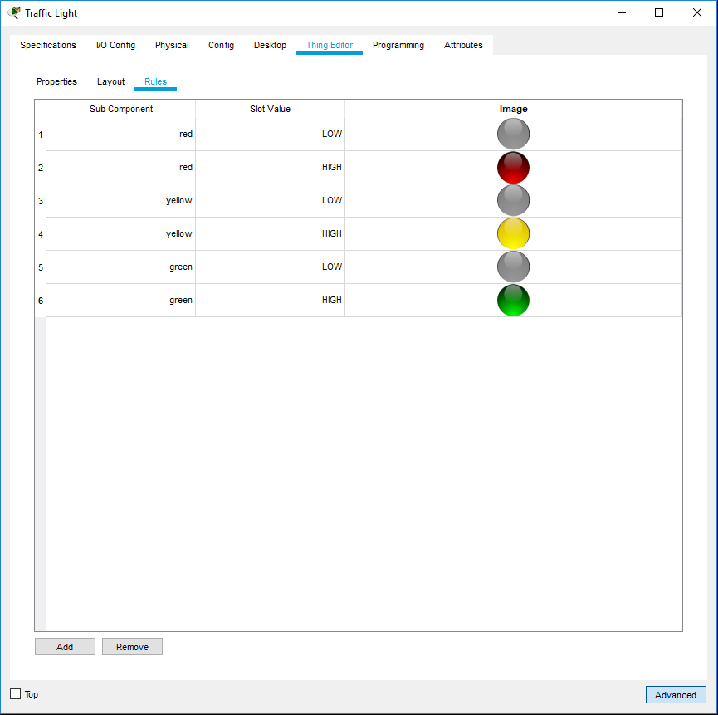
Thing Editor

Slide 20
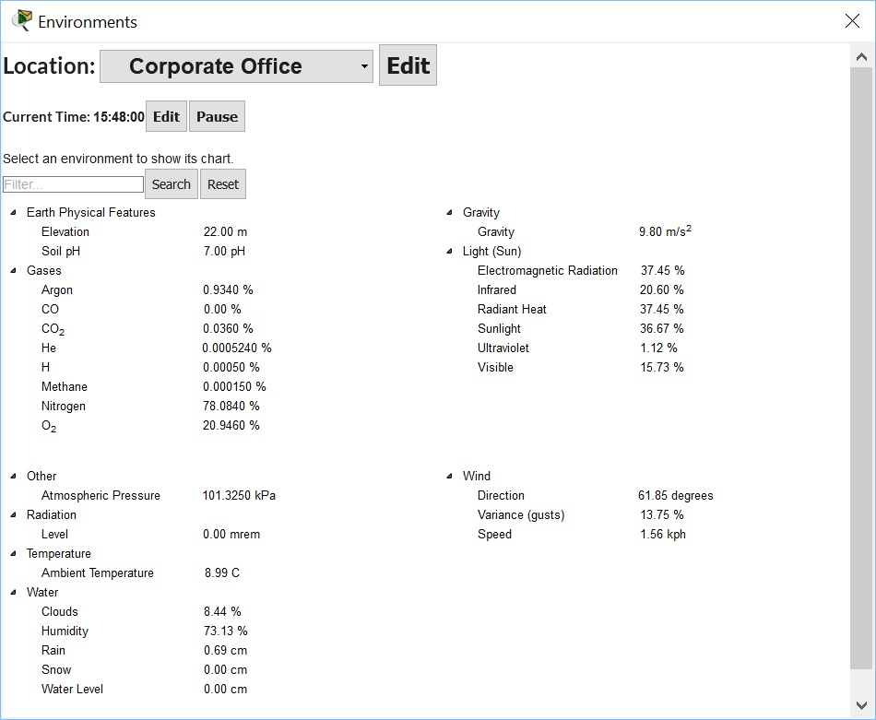
Environment Dialog

Slide 21
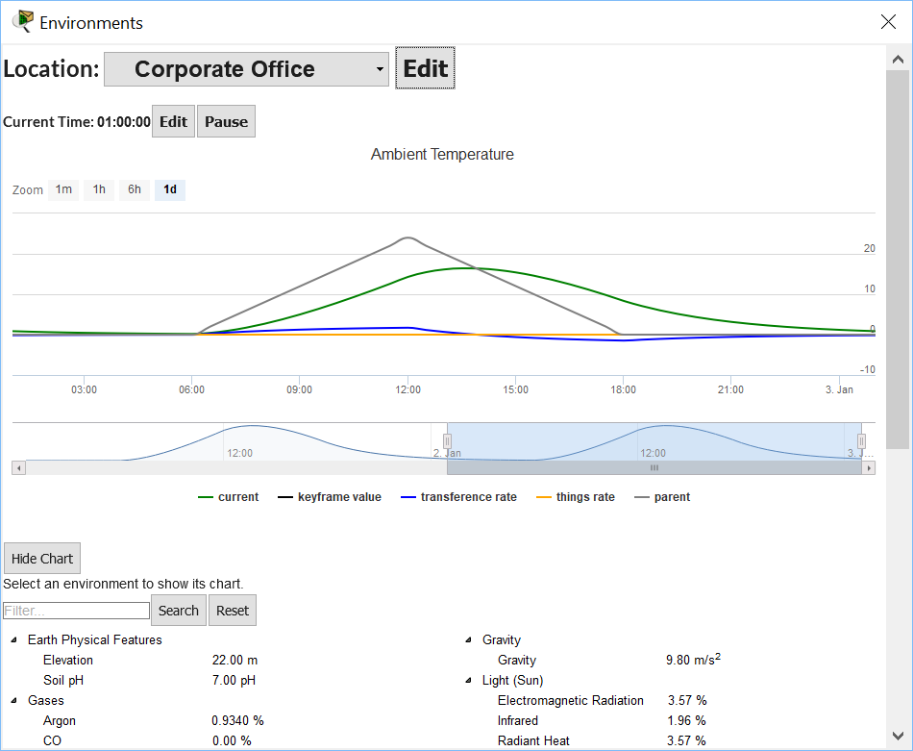
Environment Dialog Edit Mode

Slide 22
APIs
Prepacked library provide access to some major APIs and more can be added through programming feature. Below an example for http that can also be used in a real http and emulation mode
Basic Networking | Package = networking
Function | Return Type | Description | Example
localIP() | str | Returns the local IP. | ip = localIP()
subnetMask() | str | Returns the subnet mask. | mask = subnetMask()
gatewayIP() | str | Returns the gateway IP. | gateway = gatewayIP()
HTTP Client | Package = http
Function | Return Type | Description | Example
HTTPClient() | HTTPClient | Creates a HTTP Client. | http = HTTPClient()
open(url) | N/A | Gets an URL. | http.open(“http://www.cisco.com”)
stop() | N/A | Stops the request. | http.stop()
onDone(callback) | N/A | Sets the callback for when the request is done. | def onHTTPDone(status, data): print(data) ... http.onDone(onHTTPDone)

Slide 23
End of session

